Slide 1
Smart traffic light system using computer vision with web-based control panel
Student name : LONG NGO DUC
Roll number: BJ19BDS002

Slide 2
Table of content
1. PROBLEM INTRODUCTION
2. FRAMEWORK
3. CAR COUNTING MODEL
4. SIMULATION
5. WEB APP CREATION

Slide 3
1. PROBLEM INTRODUCTION

Slide 4
1. PROBLEM INTRODUCTION
Traffic congestion has always been a major issue in big cities nowadays, especially in developing countries
With the increasing number of people and cars, this issue has become worst. In the United State of America alone, almost $70 million per year lost due to traffic congestion in the business sector out of nearly $300 billion spent on gas.
Traffic signal is not good anymore and not optimize with the current traffic load
The rise of computer vision, Deep Learning has made ideas which seem impossible feasible
=> As the result, the idea of smart traffic light system

Slide 5

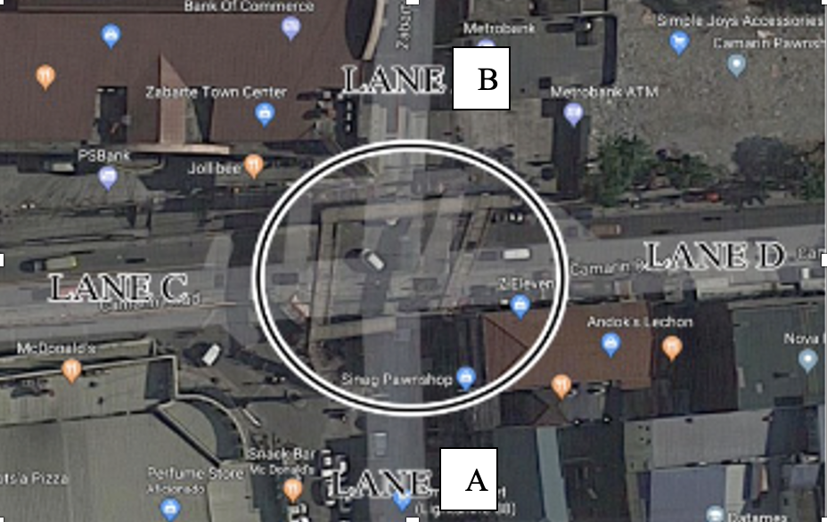
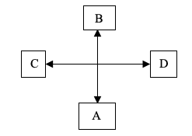
1. PROBLEM INTRODUCTION
Take the crossroad next to Mc Donald Lidcombe, Sydney, NSW
Attribute of each lane:
Road A has 2 lanes (1 straight and 1 right)
Road B has 2 lanes (1 straight and 1 right)
Road C has 4 lanes (3 straight and 1 right)
Road D has 4 lanes (3 straight and 1 right)

Slide 6
1. PROBLEM INTRODUCTION
Current traffic rules and information
Lane A go straight and right for 22 seconds
Lane B go straight and right for 22 seconds
Lane C and D go right for 30 seconds
Lane C and D go straight for 70 seconds
=> Time and rules allocated for each lane is reasonable but it is far from optimize.

Slide 7
2. Framework

Slide 8
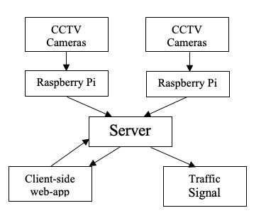
2. Framework
Theoretically, the framework should look like the graph below where CCTV cameras are installed in every lane on top of the traffic signal.
Each of the camera will be connected with a Raspberry Pi with Car Counting model installed.
These outputs will then be fed to the server which then run the algorithm to get the result of the lane which should be given green light and the duration of the light.
It is also connected to a web application that allows user interaction and the traffic signal.
After all calculation and process, the traffic light outputs the color of the light corresponded to the output made by the server. The client-side web-app can also see number of car in each lane and control the traffic signal and change the mode of algorithm.

Slide 9
2. Framework
Although this framework is not feasible to implement
The reason:
lack of hardware
permission to install cameras on top of traffic lights and intervene the traffic light system
Building the prototype of the traffic light and getting live data from 4 lanes in 1 crossroad has been considered.
However, since we do not have the control over the traffic signal of that crossroad, the nature of the number of cars increases or decreases when the algorithm allots a green light in a particular lane has not been fulfilled.
Hence, it would not show the goodness of the algorithm and we cannot see the reasonable changes on the web app when the light shifts.

Slide 10
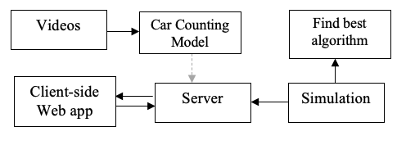
2. Framework
Actual framework used:
The video is the replacement for the visual input captured by CCTV
Fed to the car counting model is trained and implemented using various approaches.
The reason for Server not receiving direct output from the model is that the server needs real-time input from all 4 lanes while the car counting model which then be installed into the raspberry pi contains the input of only 1 lane.
Simulation is used to find the best algorithm for the server and stream live simulated data to feed into the Server.
The Server analyze the data and stream live data to Client-side web-app.

Slide 11
3. Car counting model

Slide 12
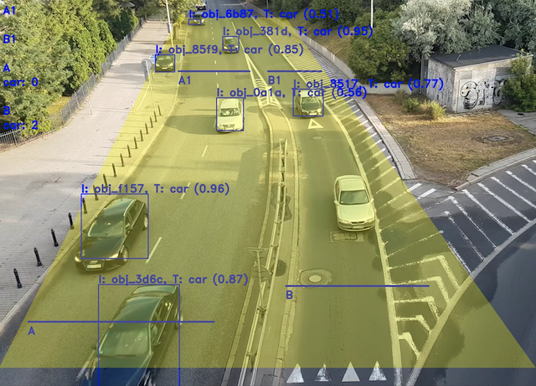
3. Car counting model
The first model is built
When car pass the line A1 or B1, increment on number of traffic load in the respective lane
When car pass the line A or B, decline on number of traffic load in the respective lane
=> it seems good but since using cumulative summation, the counts have lots of error only after a short time of operating

Slide 13
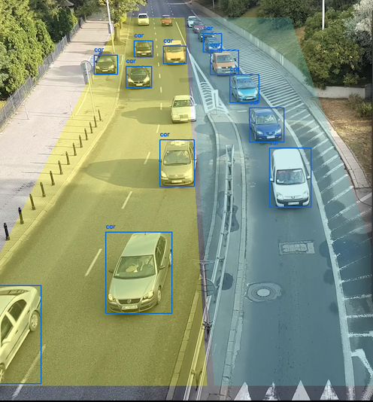
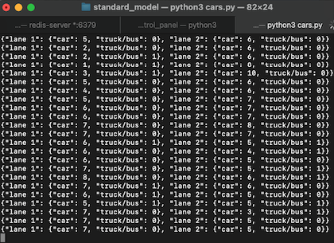
3. Car counting model
Chosen model
The chosen model draws 2 droi representing for 2 lanes
Car in the droi will be counted
Not using cumulative summation so not vulnerable with error
Only analyze 1 every frame (take 1 frame every 1 second)
Output in json format

Slide 14
4. Simulation

Slide 15
4. Simulation
Function created:
get_truncated_normal: random number follow normal distribution
check_normal_distL: check normal dist
car_initialization: initialize car
car_generator: car increase
car_leave: car decrease
Convert_load and time_wait
Evaluation: get the point of each algo

Slide 16
4. Simulation
-Rules that this crossroad follows:
Lane A go straight and right for 22 seconds
Lane B go straight and right for 22 seconds
Lane C and D go right for 30 seconds
Lane C and D go straight for 70 seconds

Slide 17
4. Simulation
algo1:
Find the car ratio with number of lanes. And use convert_load function to convert the load per lane.
The algo1 will iterate through a list of rules that is stored in a list of tuples. It will allow 2 lanes which are not blocking each other go green at the same time. We named the lane as below
From lane A, the algorithm at 1 time will accept 1 one the following scenario:
Lane A go straight and right
Lane A and Lane B both go straight
Lane A go straight, and Lane D turn right
Lane A go right, and lane C go straight
Same for other lane, the logic is to maximize the lane go in one time while preventing lane blocked.

Slide 18
4. Simulation
algo2:
the algo2 is implemented on top of the algo1.
Same logic is share between the two.
The only difference is that the green time will stop automatically when the lanes which are given the green light have lower traffic load than a certain threshold (0.5 in this case).

Slide 19
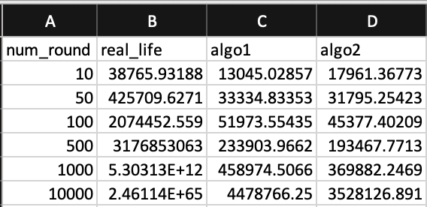
4. Simulation
Performance:
- From the table above, we can see the huge difference in the performance of real_life and the 2 algorithms.
The performances differ even more when the number of iteration increase. The algo1 performs slightly better than algo2 in the simulation with the iteration number of 10 but worse in others.
Reason for this maybe the initialization of algo2 at the simulation with 10 iterations is worse the initialization of algo1.
=>Nevertheless, we can conclude the algo2 is the best algorithm and will be used for the Server.

Slide 20
5. Web application

Slide 21
5. Web application
- simulation code is integrated into the web app.
- reason for not rewrite in simulation in JavaScript:
Advantage:
more dynamic website
Does not have to worry about data streaming
Disadvantage:
If integrate car counting model, we have to stream data anyway
Not a way we suppose to do it if this application syncs up
- The actual website will be turned on and shown during presentation

Slide 22
Thank you for your attention

